Slide 2
ET4730 Computer Graphics

Slide 3

OpenGL
Lecturer: Nguyen Dinh Van, PhD.

Slide 4
Content
Introduction to OpenGL
GLEW, GLFW, GLM
Rendering Pipeline

Slide 5
1. Introduction

Slide 6
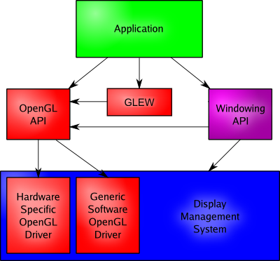
OpenGL
A cross-platform API that allows graphical manipulation and rendering on physical devise
API: Application Programming Interface
Created: Silicon Graphics – 1992
Managing by: Khronos Group (Industrial Standard)
Cross-platform
Provide industrial level API for manipulation and rendering of graphical information

Slide 7
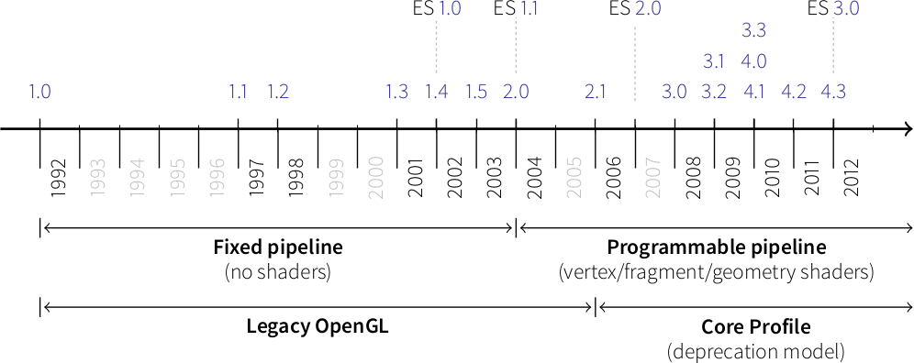
OpenGL
Has multiple variations
Two majors:
Legacy OpenGL (old version – fixed pipeline)
CoreProfile OpenGL (newer version – programmable pipeline)
CoreProfile is supported by almost all modern devices

Slide 8
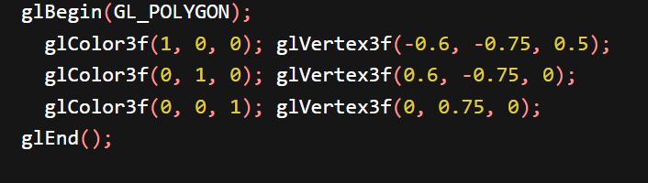
OpenGL
Fixed pipeline:
The processing steps are fixed
Can only change some parameters
No programming / calculation possible
Examples

Slide 9
OpenGL
Programmable pipeline:
The processing steps can be programmed
Can write a small program to do calculation, transformation etc.
Examples
TriangleShader.cpp
Differences:
 | Fixed pipeline | Programmer pipeline
Limitation | Can only have limited set of pre-programmed functions | Can implement new functions
Hardware | Custom computation on CPU | Custom computation on GPU
Implementation | Easier for small scale, more complex in large scale | Complex for small scale, scalable

Slide 10
OpenGL
Legacy OpenGL:
Allow backward compatibility for old Opengl functions (fixed pipeline)
Can sometimes cause error in modern hardwares / softwares
Core Profile:
Introduce concept of deprecation
Deprecation allows OpenGL only be optimized for modern features / extensions
Disable backward compatibility (before OpenGL 3.1)

Slide 11
GLEW
GLEW: OpenGL Extension Wrangler
Allow load and test for compatibility of extensions (programmable pipeline)
Other alternatives: GL3W, glLoadGen, glad, glsdk, Glee…
To init GLEW:
glewinit()
Check for an extension existence:
if(!GLEW_EXT_framebuffer_object)

Slide 12
GLFW, SDL
GLFW: OpenGL FrameWork
Allow windows creation and management
Handle user interactions
Support multiple monitors
Using the current OS context
Allow OpenGL to behaves in different OSes
Alternative: SDL (Simple DirectMedia Layer)
Has GLFW functionality
Can process sound, multithread etc.

Slide 13
GLM
GLM: OpenGL Mathematics
A library in C++ for mathematics with OpenGL
Cross-platform
Can do complex rendering, image rasterization and graphics manipulation
References: https://glm.g-truc.net/

Slide 14
Rendering pipeline & Shaders
Rendering pipeline
Series of events happen from beginning of data to GPU to monitor display
Optimized for GPU processing
Some steps can be programmable
Shaders:
Mini-program written to be executed in rendering pipeline (programmable)
Using GLSL language (OpenGL Shading Language)
GLSL is extended from C
Often written to a separated text file, not compiled with the program

Slide 15
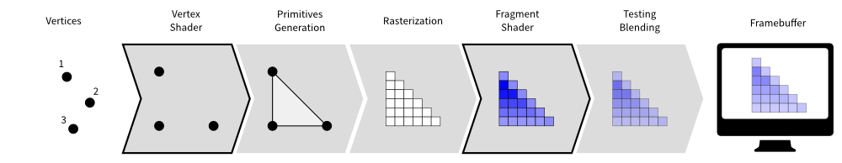
Rendering pipeline
7 steps:
Vertices Specification
Vertices Shader (P)
Primitives Generation
Rasterization
Fragment Shader (P)
Testing Blending
FrameBuffer

Slide 16
VAO & VBO
VAO: Vertex Array Objects
Describe data structure for vertices (position, color, direction, …)
VBO: Vertex Buffer Objects
Actual data of vertices (comply with the structure in VAO)
Attribute Pointer
Allow shaders access data in VBO.
VAO and VBO are loaded directly to GPU
Stored on GPU
Processed on GPU

Slide 17
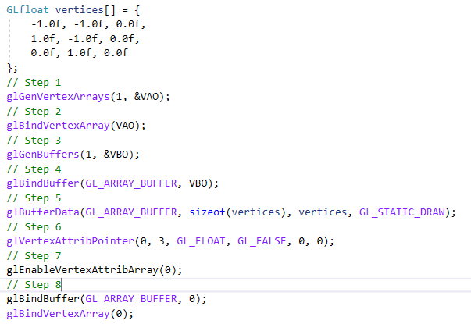
VAO & VBO
VAO, VBO in the code are just numbers
Create a VAO ID
Connect VAO to the ID
Create a VBO ID
Connect VBO to the ID (Connection between VAO and VBO will be done automatically)
Assign value to VBO
Define Attribute Pointers
Allow attribute pointers to work
Free VAO, VBO. Ready for the next object.

Slide 18
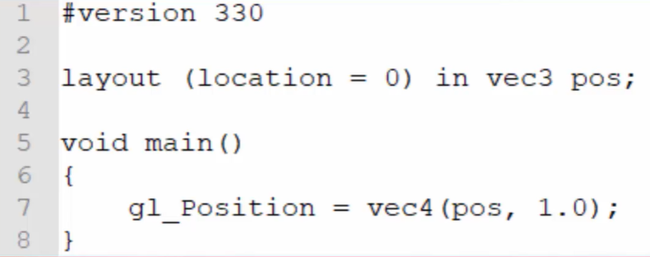
Vertex Shader
Programs that can be run on GPU
Required
Allow computation on input vertices
Allow adding more data later on
Example

Slide 19
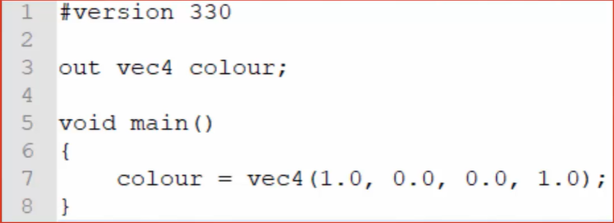
Fragment shader
Fragment: result from rasterization step
Collection of pixels to display input images
These pixels can be transparent, blur or not displayed due to viewport
Fragment shader: manage and process data of fragments
Such as color of a fragment
A simplest OpenGL program requires both vertex shader and fragment shader

Slide 20
Shader program
Shader program: a program contains set of shaders (Vertex, fragment shaders …)
Create inside OpenGL with following process:
An empty shader program is initialized
A set of empty shaders created
Assign shader code to respective-shader (Vertex shader code to empty vertex shader)
Compile shaders
Assign shaders to the shader program
Link shaders together
Testing and verification

Slide 21
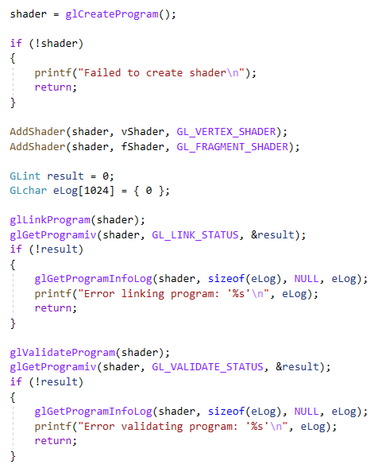
Shader program
Identify setps of shader program

Slide 22
Practice
Try different shapes drawing with OpenGL
Try colouring OpenGL

Slide 23
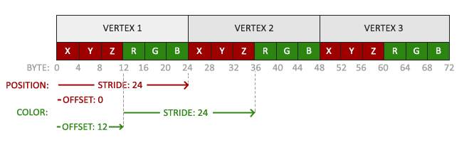
Practice
Position layout

Slide 24
Practice
glDrawArrays(GLenum mode,GLint first, GLsizei count);
Mode: Specifies what kind of primitives to render. Symbolic constants are
First: Specifies the starting index in the enabled arrays.
Count: Specifies the number of indices to be rendered.
Accepted mode:
GL_LINE_STRIP, GL_LINE_LOOP, GL_LINES, GL_LINE_STRIP_ADJACENCY, GL_LINES_ADJACENCY, GL_TRIANGLE_STRIP, GL_TRIANGLE_FAN, GL_TRIANGLES, GL_TRIANGLE_STRIP_ADJACENCY, GL_TRIANGLES_ADJACENCY and GL_PATCHES

Slide 25
THANK YOU !

